Slide 1
AE Cloud2 Arduino Compass Sensor BMC150

Slide 2
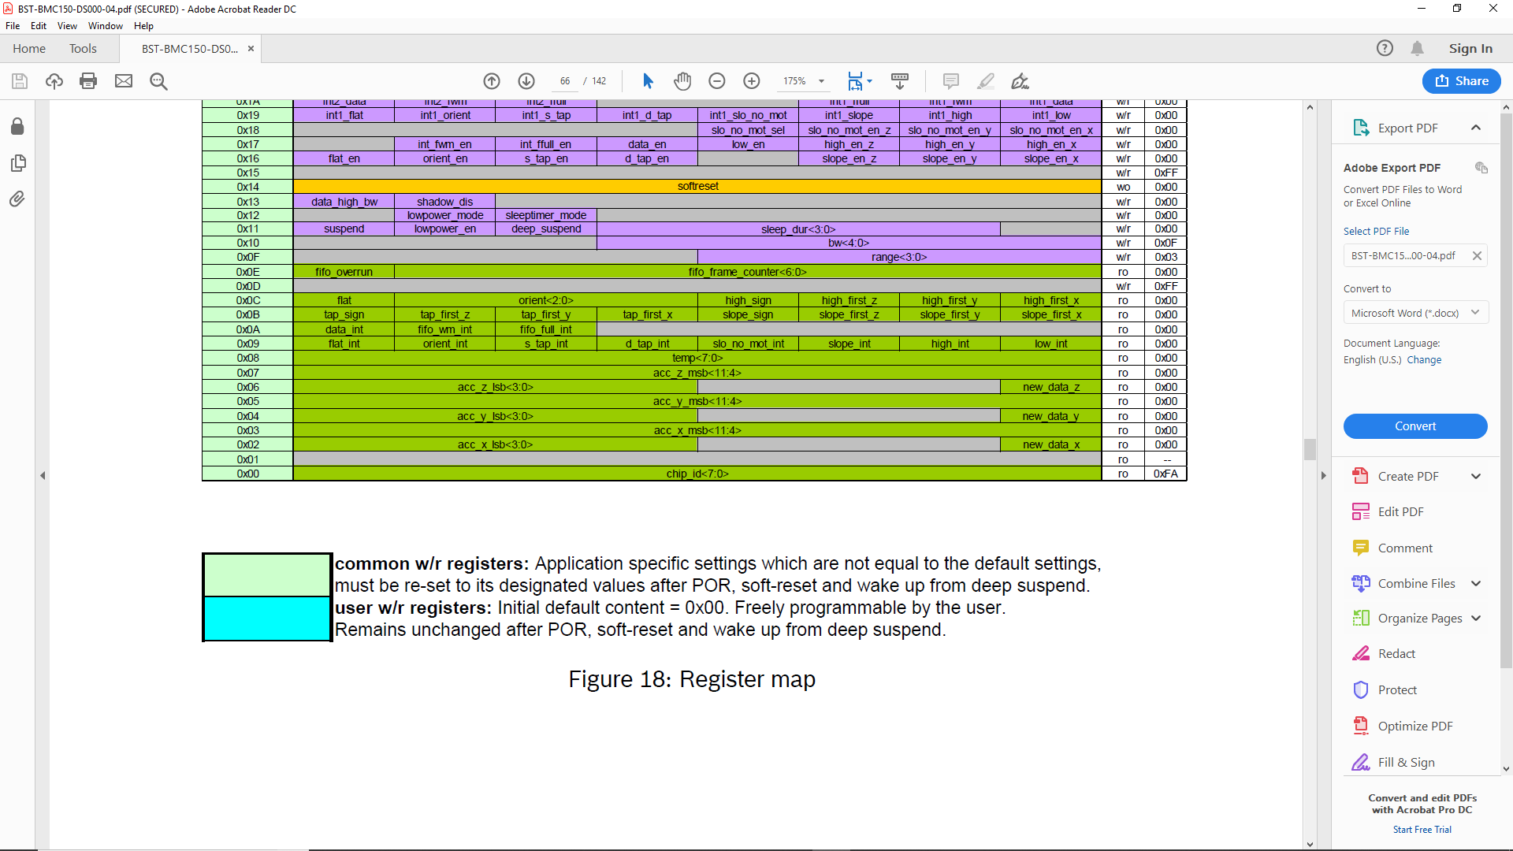
Register Map

Slide 3
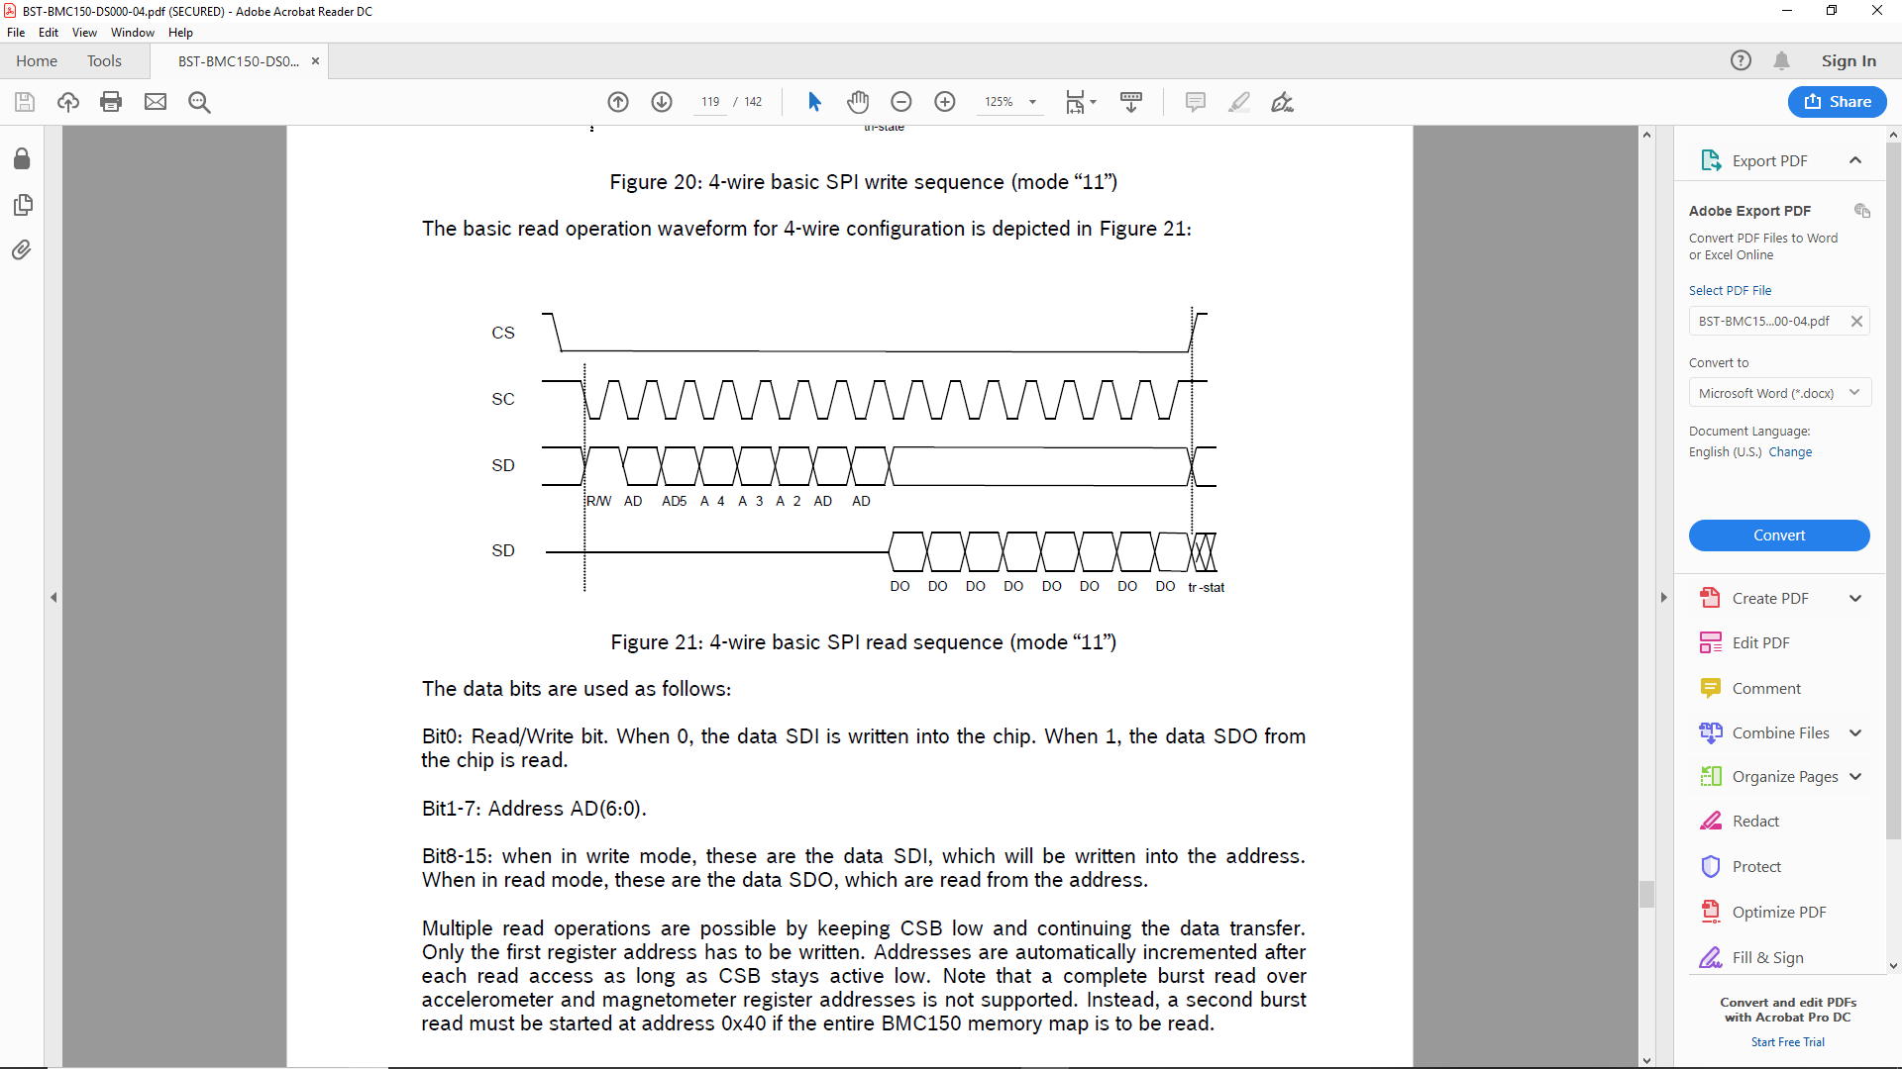
SPI Read/Write

Slide 4
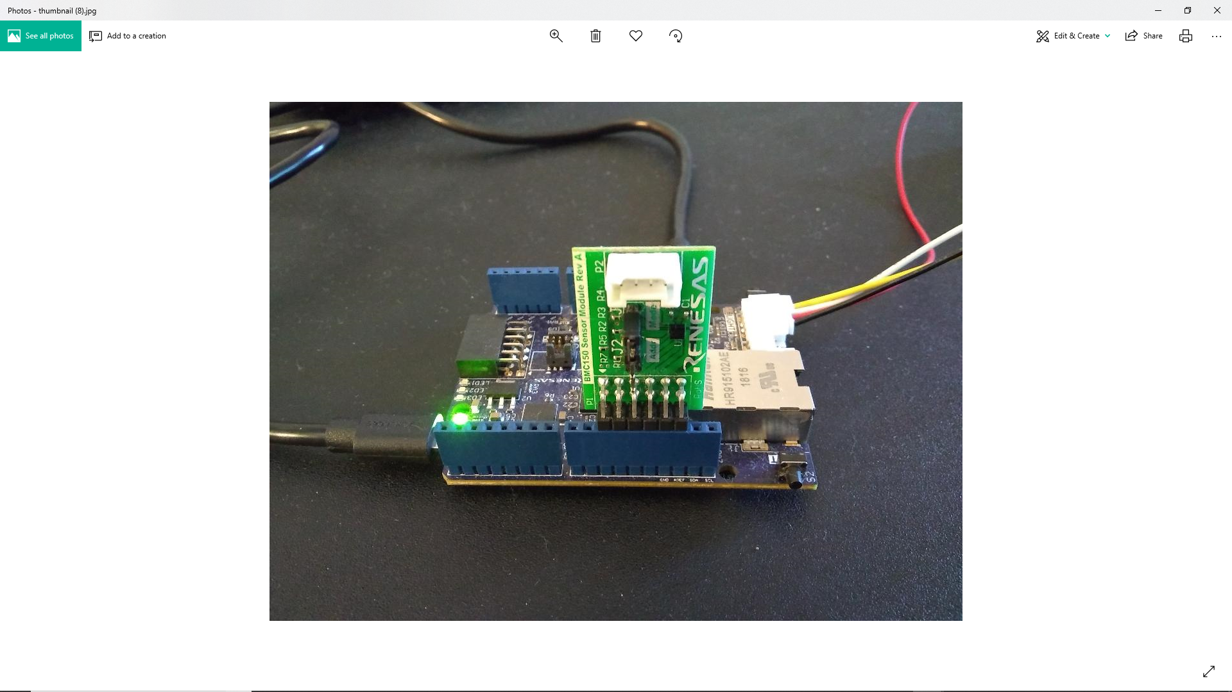
Hard ware Setup (D10,11,12,13,GND,VCC)

Slide 5
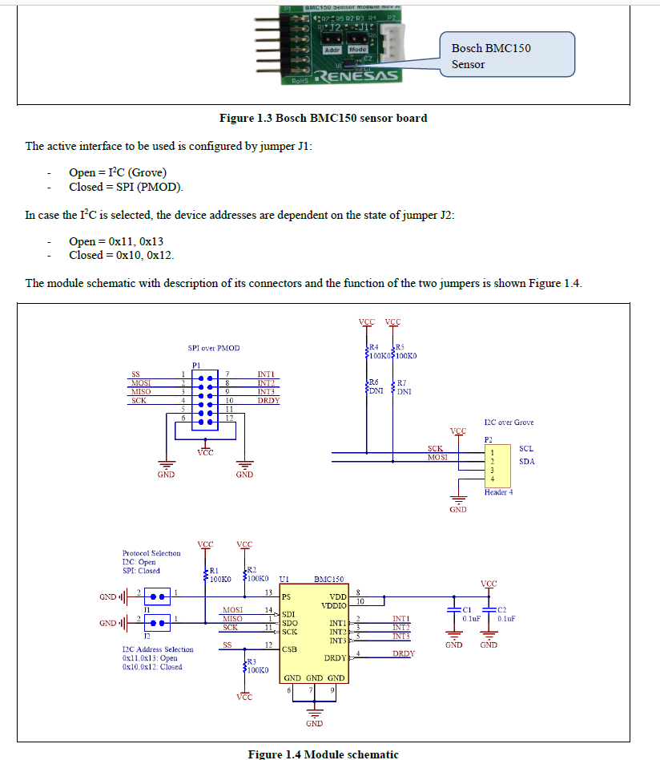
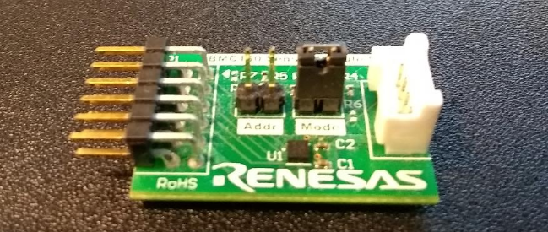
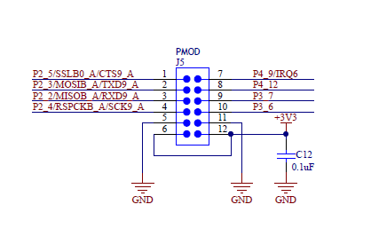
BMC150 schematic / PMOD schematic
Leave these output pins unconnected.

Slide 6
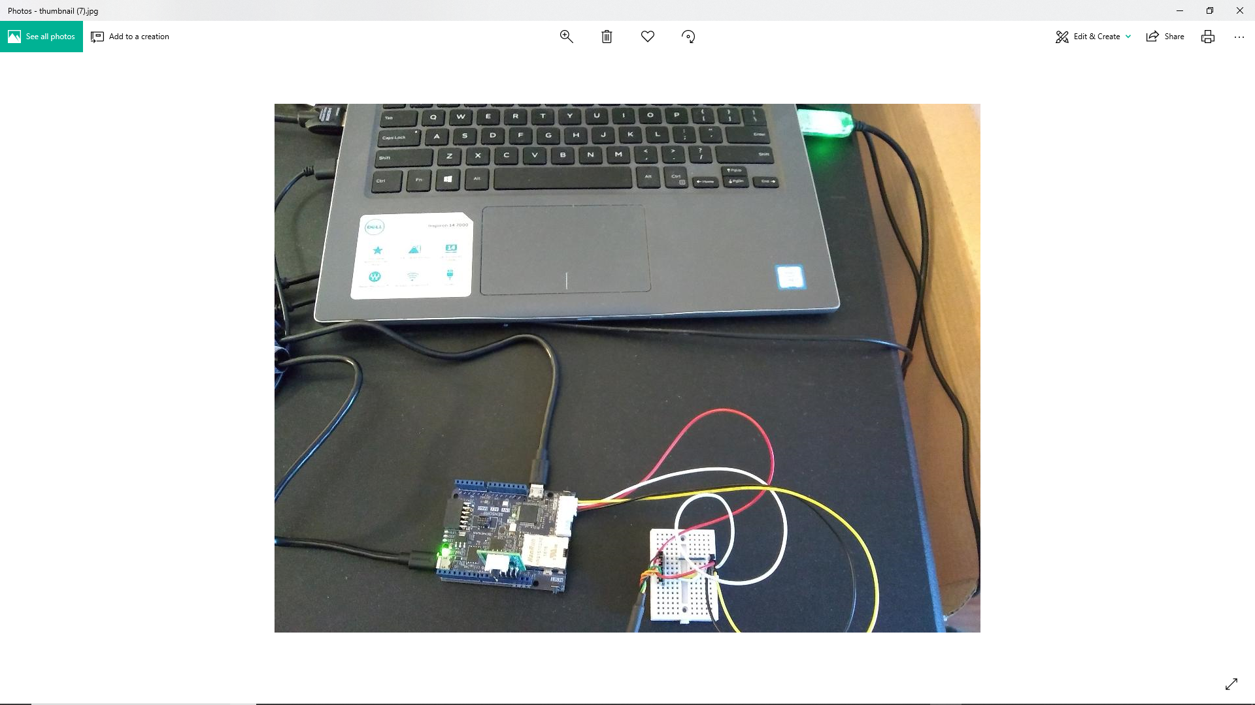

Slide 7
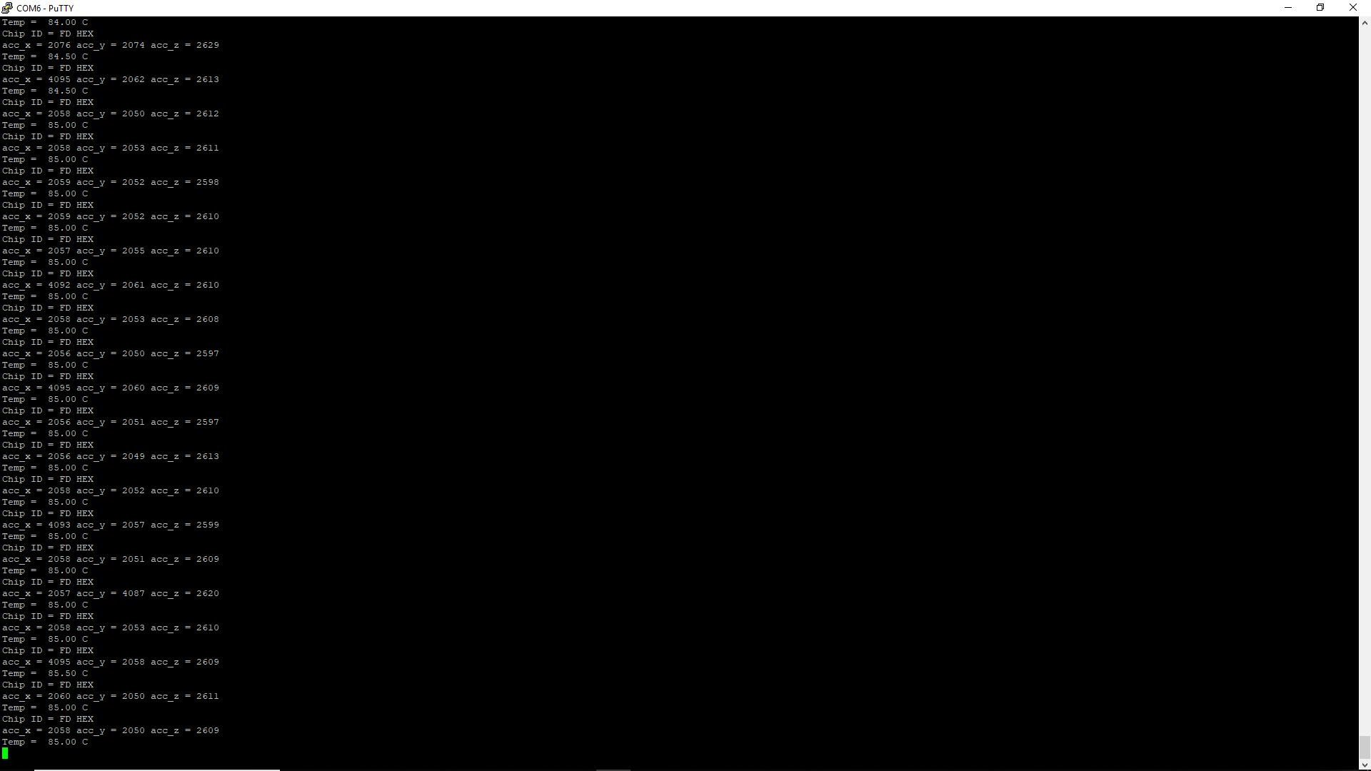
Data

